Slide 1
RF Survey Toolkit
Mats De Meyer

Slide 2
Requirements
RF Survey kit
Query available gateways (dash7)
Parse responses (ALP commands)
BLE link to smartphone
Store location of deadspots/gateway responses
Store results in JSON file

Slide 3
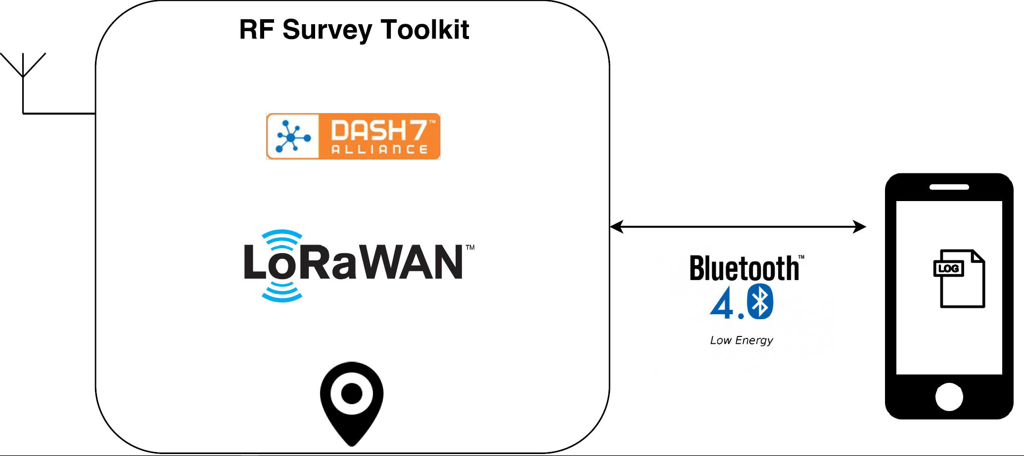
Initial sketch

Slide 4
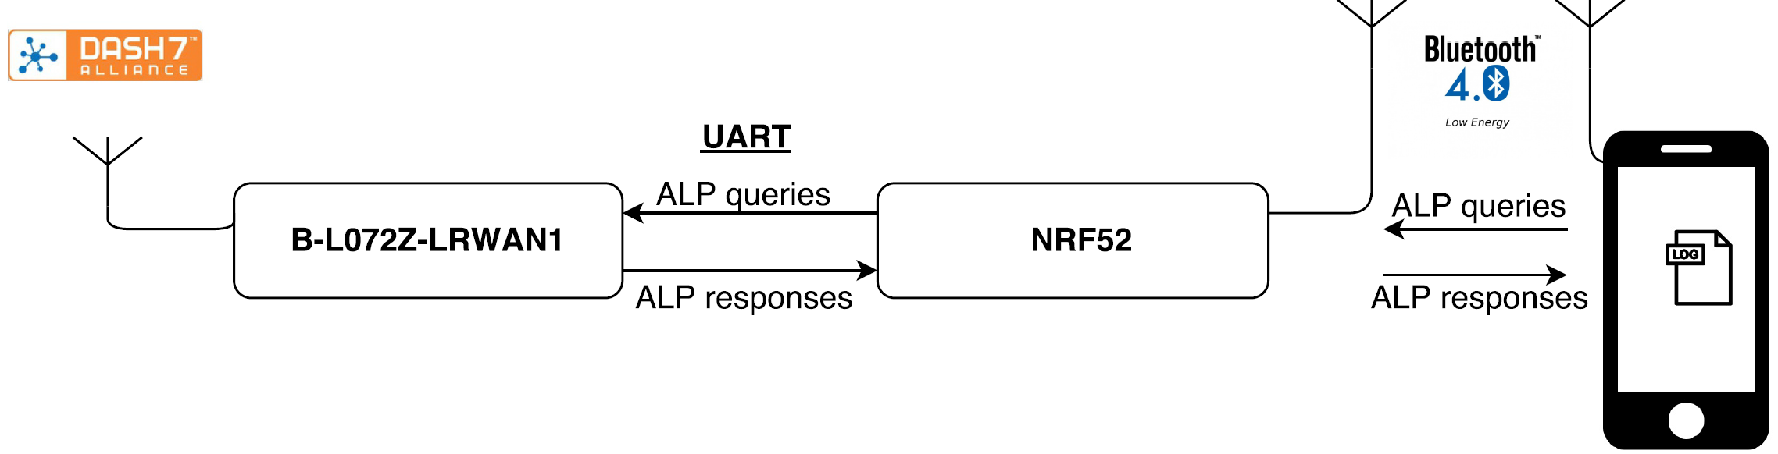
Architecture

Slide 5
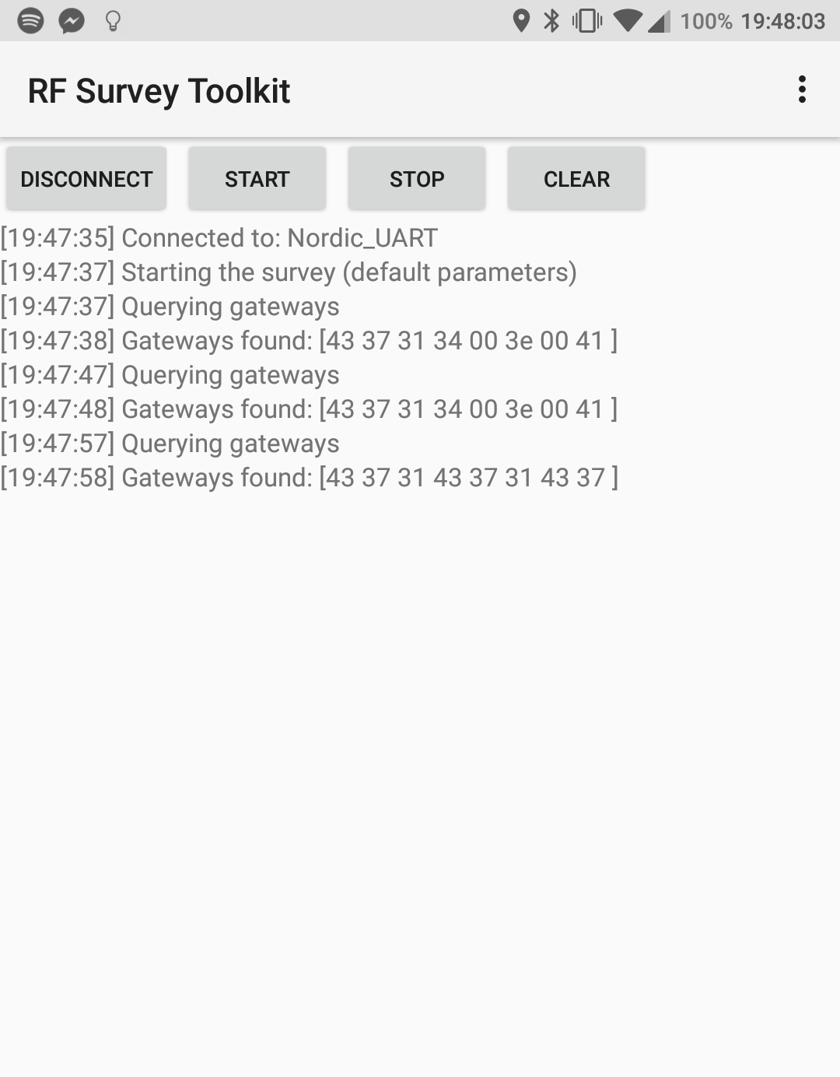
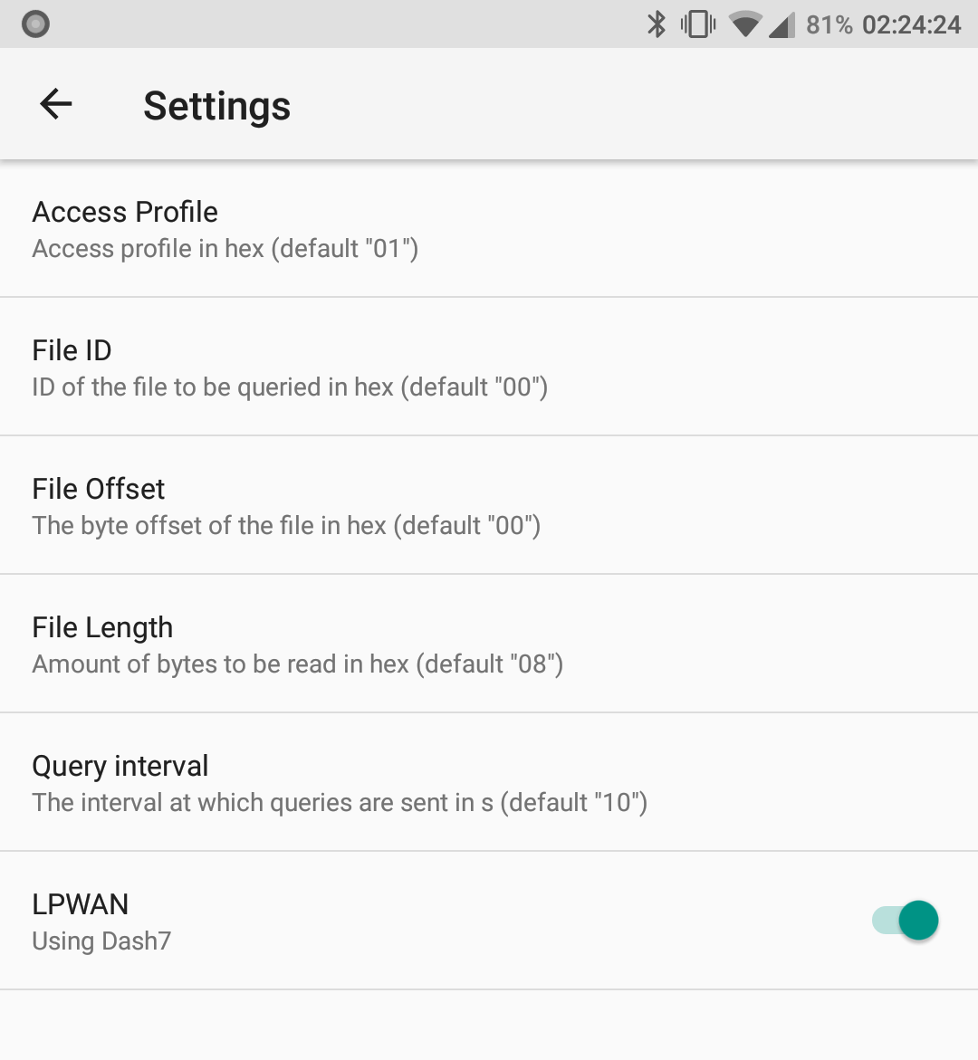
Result

Slide 6
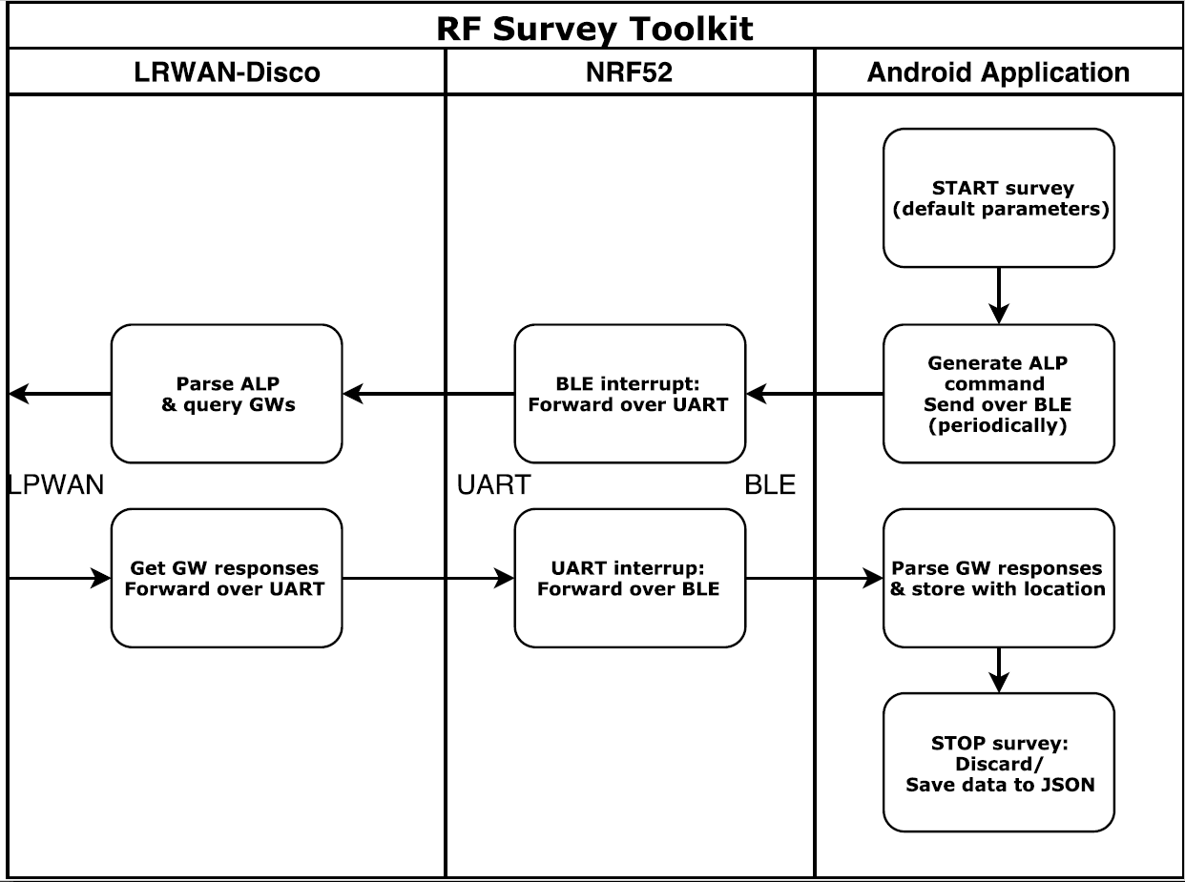
Code Flow: Reachable Gateways

Slide 7

Code Flow: No Gateways

Slide 8
Future work
Working prototype
More extensive testing (more gateways)
More generic parser
Process JSON files

Slide 9


